Slide 1
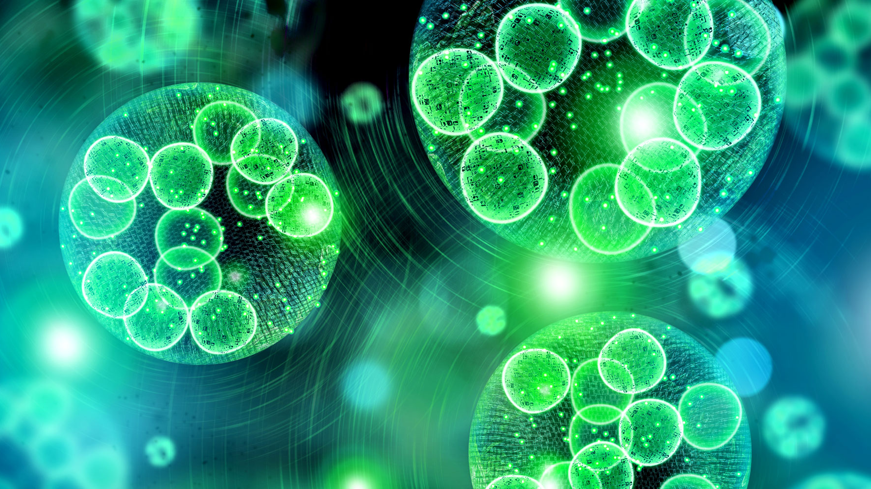
Title: Effects of hydrogen peroxide (H₂O₂) on the growth of different bloom-forming cyanobacteria
Kishor Kumar Tikadar
BIO-5202
Date: 05.06.2025

Slide 2
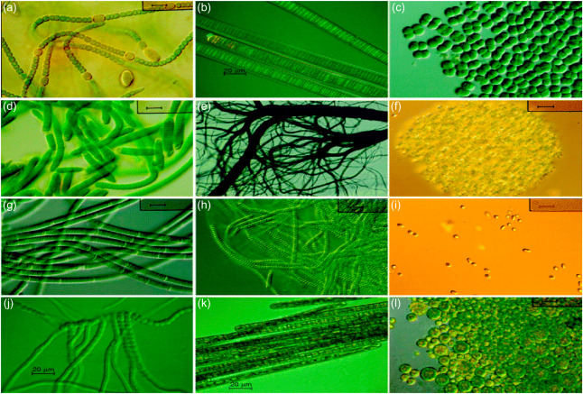
Why Cyanobacteria?
CyanoHABs are rapidly increasing globally
Produce potent toxins
Threatening aquatic ecosystems, biodiversity, water quality, and public health
Nutrient loading (eutrophication) and global warming
Effective controls methods are yet to be established
(Source: Mishra, 2020)

Slide 3
Research question
How does hydrogen peroxide (H₂O₂) affect the growth of different bloom-forming cyanobacterial species?
Objectives
Evaluate the inhibitory effects of hydrogen peroxide on the growth dynamics of various cyanobacterial bloom species.

Slide 4
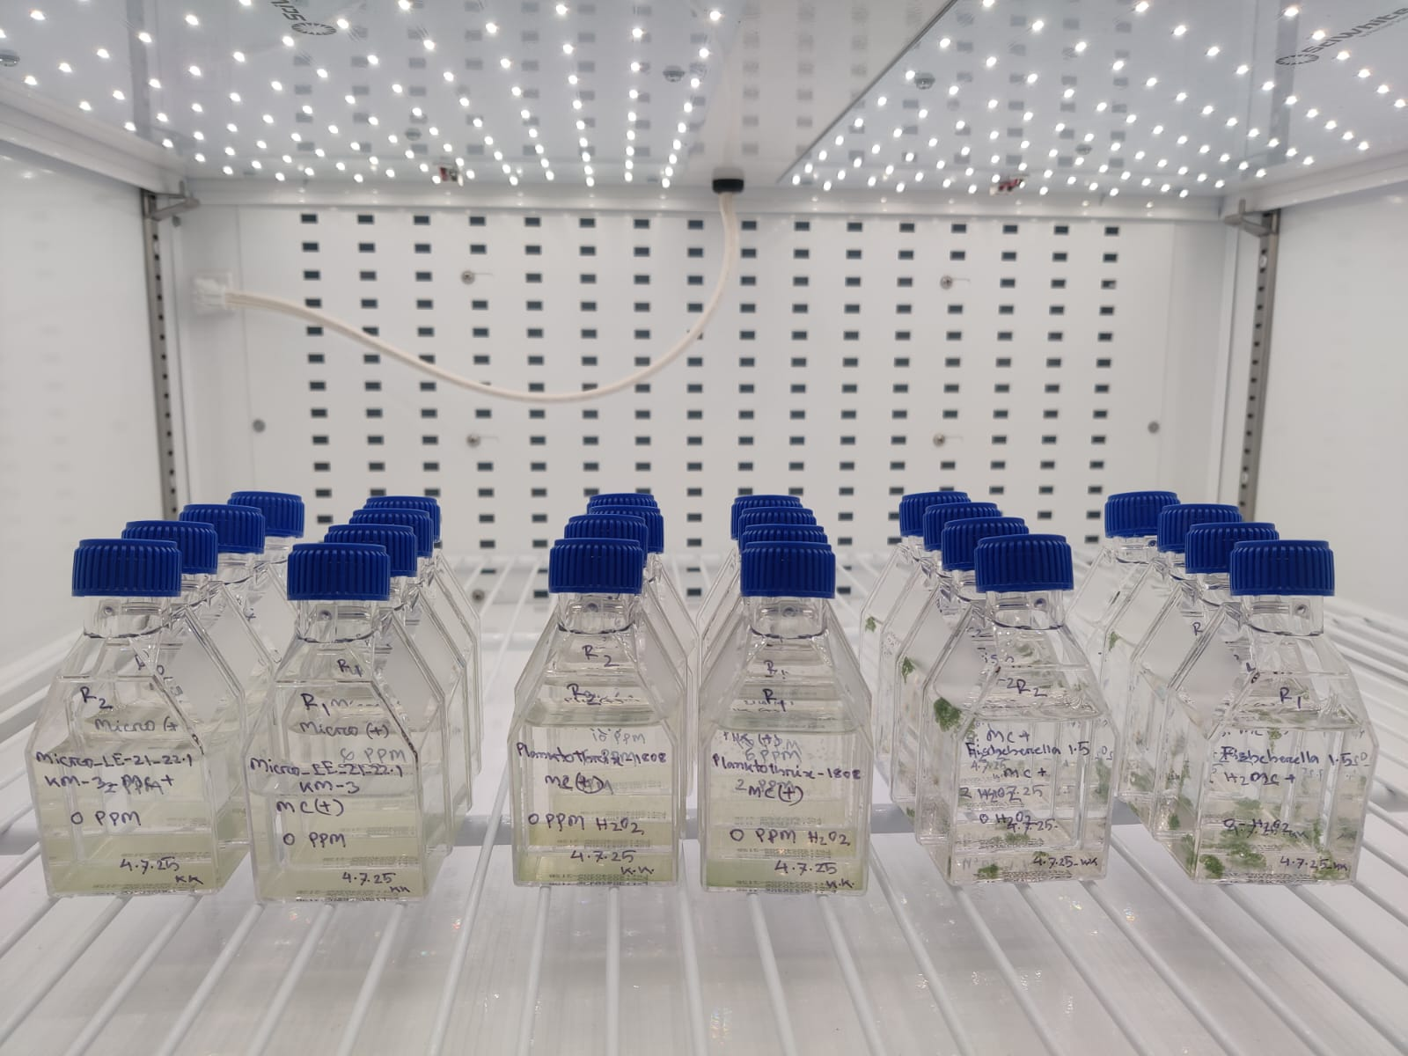
Experimental Design
Cyanobacteria: Microcystis_LE21, Planktothrix_1808, and Fischerella_1.5
Microcystin: Positive
Algaecide: PAK 27
Treatment: 0, 2, 6, and 10 PPM
Replication: 2
Growth Parameter: Chl-a, PC
Duration: 7 days
Temperature: 23˚C
Light: 30 µmol/m2/s
Cycle: 12h : 12h (light : dark)
Sampling frequency: 1 ml per day

Slide 5
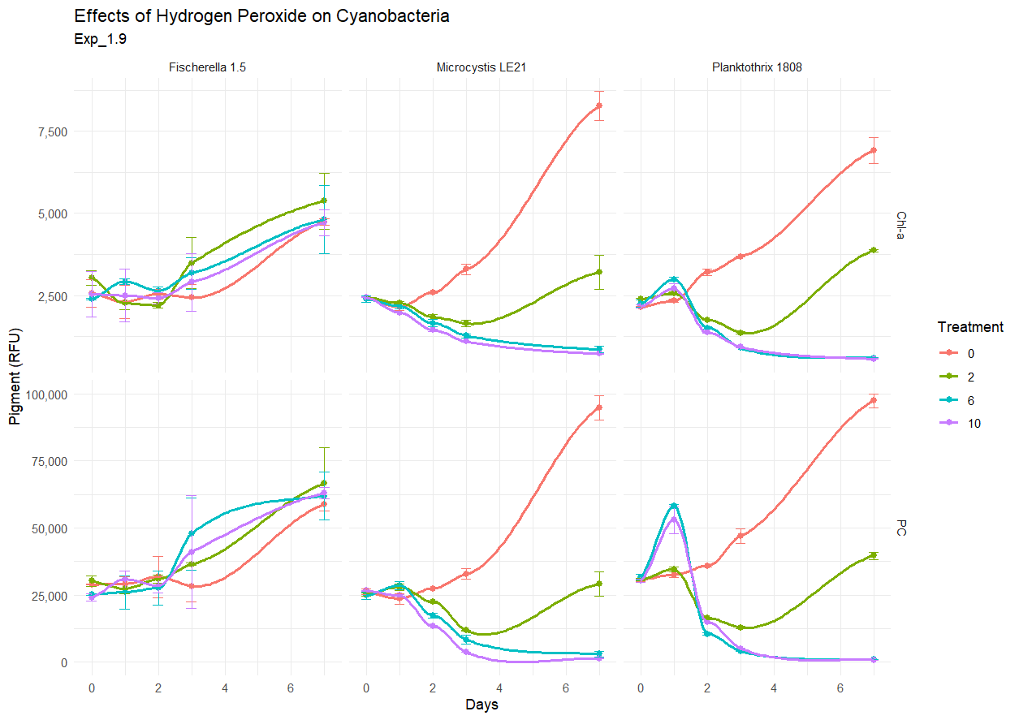
Effects of Hydrogen Peroxide on the Growth of Cyanobacteria

Slide 6
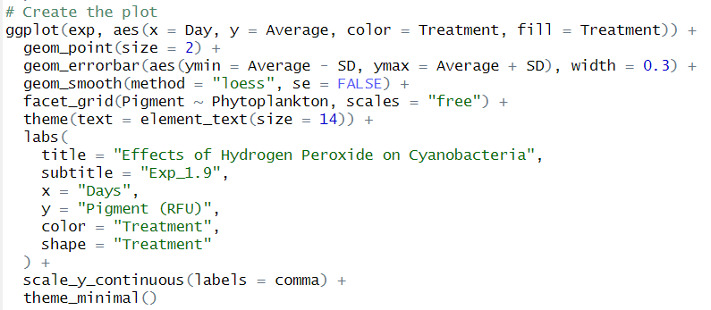

Codes to generate multi-panel graph

Slide 7
ANOVA
Microcystis
Planktothrix
Fischerella

Slide 8
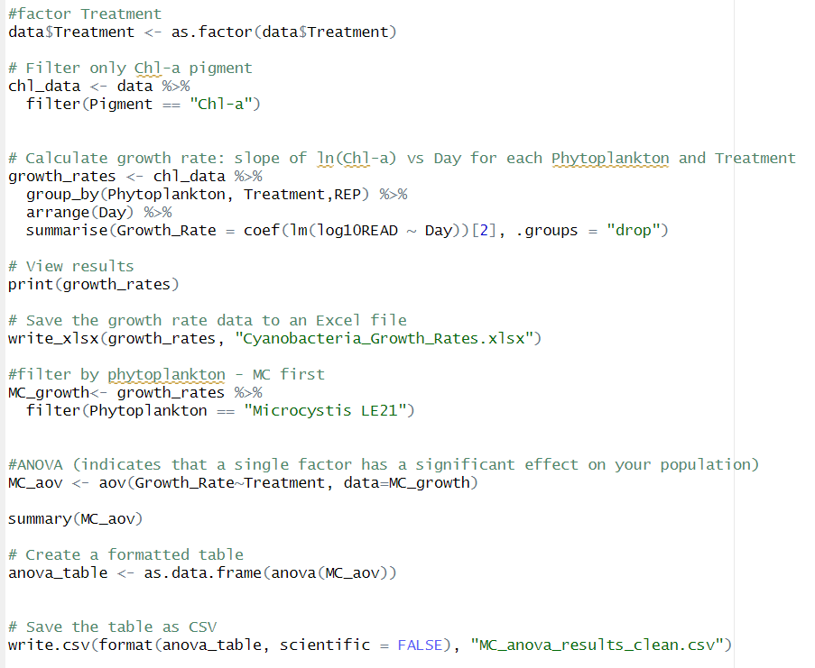
Codes for ANOVA

Slide 9
References
Akther, F., & Cutright, T. J. (2024). Control of Cyanobacterial Algal Blooms and Soluble Reactive Phosphorus Using PAK-27 and Phoslock®. Water Conservation Science and Engineering, 9(2), 66. https://doi.org/10.1007/s41101-024-00302-7
Faraway, J. J. (2002). Practical regression and ANOVA using R (Vol. 168). Bath: University of Bath.
Ito, K., & Murphy, D. (2013). Application of ggplot2 to pharmacometric graphics. CPT: pharmacometrics & https://doi.org/10.1038/psp.2013.56
Jiang, Y., Fang, Y., Liu, Y., Liu, B., & Zhang, J. (2022). Community succession during the preventive control of cyanobacterial bloom by hydrogen peroxide in an aquatic microcosm. Ecotoxicology and Environmental Safety, 237, 113546.
Mirman, D. (2017). Growth curve analysis and visualization using R. Chapman and Hall/CRC.
Mishra, S. (2020). Cyanobacterial imprints in diversity and phylogeny. In Advances in Cyanobacterial Biology (pp. 1-15). Academic Press.
Yang, Z., Buley, R. P., Fernandez-Figueroa, E. G., Barros, M. U., Rajendran, S., & Wilson, A. E. (2018). Hydrogen peroxide treatment promotes chlorophytes over toxic cyanobacteria in a hyper-eutrophic aquaculture pond. Environmental https://doi.org/10.1016/j.envpol.2018.05.012 Pollution, 240, 590-598.

Slide 10


